Slide 1
Five Number Summary

Slide 2
Descriptive Statistics involves understanding the distribution and nature of the data. Five number summary is a part of descriptive statistics and consists of five values and all these values will help us to describe the data.
The minimum value (the lowest value)
25th Percentile or Q1
50th Percentile or Q2 or Median
75th Percentile or Q3
Maximum Value (the highest value)
A quartile is an observed value at a point that aids in splitting the ordered data sample into four equally sized parts. The median, or 2nd Quartile, splits the ordered data sample into two parts, and the 1st and 3rd quartiles split each of those halves into quarters.
A percentile is an observed value at a point that aids in splitting the ordered data sample into 100 equally sized portions. Quartiles are often also expressed as percentiles.

Slide 3
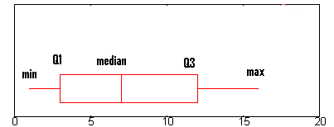
Both the quartile and percentile values are examples of rank statistics that can be calculated on a data sample with any distribution. They are used to quickly summarize how much of the data in the distribution is behind or in front of a given observed value. For example, half of the observations are behind and in front of the median of a distribution.

Slide 4
How to calculate Five Number Summary
Let’s understand this with the help of an example . Suppose we have some data such as : 11,23,32,26,16,19,30,14,16,10
Here, in the above set of data points our Five Number Summary are as follows :
First of all , we will arrange the data points in ascending order and then calculate the summary : 10,11,14,16,16,19,23,26,30,32
Minimum value: 10
25th Percentile: 14
Q1=14
Calculation of 25th Percentile : (25/100)*(n+1) = (25/100)*(11) = 2.75 i.e 3rd value of the data
50th Percentile : 17.5
Q2=17.5(Median)

Slide 5
Calculation of 50th Percentile : (16+19)/2 = 17.5
75th Percentile : 26
Q3=26
Calculation of 75th Percentile : (75/100)*(n+1) = (75/100)*(11) = 8.25 i.e 8th value of the data
Maximum value: 32

Slide 6


